Slide 1
Time Complexity and Growth of a Function
Analysis of Algorithms
Teacher : Mariha Asad

Slide 2
Time Required by Algorithm
Best case:
Minimum time required for program execution
Average case:
Average time required for program execution
Worst case:
Maximum time required for program execution

Slide 3
Time Complexity
Time Complexity of algorithm/code is not equal to the actual time required to execute a particular code but the number of times a statement executes.
Now, the question arises if time complexity is not the actual time require executing the code then what is it?
The answer is : Instead of measuring actual time required in executing each statement in the code, we consider how many times each statement execute.

Slide 4
Time Complexity
#include<iostream>
using namespace std;
int main()
{ int a;
cin>> a;
cout << “Hello world”;
return 0;
}

Slide 5
Time Complexity
#include<iostream>
using namespace std;
int main(){
int n =4;
for(int i = 0; i < n; i++ ) n+1
cout << “Hello world”;} n
return 0;
}
n=4
2n+1 = 9
0<4
1<4
2<4
3<4
4<4

Slide 6
Time Complexity
Constant O(1):
Time taken is independent of the amount of data
Stack push and pop
Queue enqueue and dequeue
Insert a node in the start of linked list

Slide 7
Time Complexity
Logarithmic O(logn)
Time taken is proportional to the logarithmic of amount of data
Binary search (a sorted list)
Search a binary tree
Log 8 = 3
Log₂ 8 = Log₂ 2³
^{n=8}
³
^{Logn}

Slide 8
Time Complexity
Linear O(n)
Time taken is directly proportional to the amount of data
Linear search
Count items in a list
Compare a pair of strings

Slide 9
Time Complexity
Linearithmic O(n logn)
Time taken is proportional to the logarithmic of data. Multiplied by the amount of data
Merge sort
Quick sort

Slide 10
Time Complexity
Quardratic O(n²)
Time taken is proportional to the square of amount of data
Bubble sort
Insertion sort
Selection sort
Traverse a 2D Array

Slide 11
Time Complexity
Polynomial O(n^{k})
Time taken is proportional to the amount of data raised to the power of a constant

Slide 12
Time Complexity
Exponential O(k^{n})
Time taken is proportional to constant raised to the power of amount of data
N-Queen problem
Traveling Salesman Problem

Slide 13
Time Complexity
Constant | O(1)
Logarithmic | O(logn)
Linear | O(n)
Quadratic | O(n²)
Polynomial | O(n^{k})
Exponential | O(k^{n})

Slide 14
Growth of a Function
Asymptotic notation:
The notation is used to describe the running time of an algorithm
This notation is convenient for describing the worst running time of algorithm
Asymptotic notation is bound to input size (depend on input size).
Ο Notation
Ω Notation
θ Notation

Slide 15
Asymptotic notation
High level idea
Suppress constant factors and lower order terms
  Constant factors: too system dependent
  Lower order terms: irrelevant for large inputs
Representing a function in a communicable form
Example: an² + bn + c is just O(n²)

Slide 16
Asymptotic Analysis
Lets assume an algorithm can be represented as f(n);
Where n is the input size. We need to calculate the running time of f(n).
We define another function lets call it g(n) which represents the running time of the algorithm.
Now three inequalities are possible
f(n) < g(n)
f(n) = g(n)
f(n) > g(n)

Slide 17
Asymptotic Analysis
Big-Oh (O)
Upper bound of f(n)
Definition:
f(n) = O(g(n)) if there exist positive constants c and n₀ such that
0 ≤ f(n) ≤ c g(n) for all n ≥ n₀

Slide 18
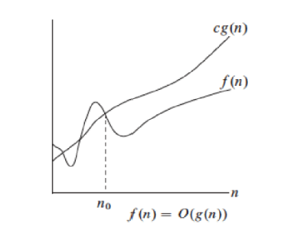
Big-Oh (O)

Slide 19
Asymptotic Analysis
Big-Omega (Ω)
Lower bound of f(n)
Definition:
f(n) = Ω(g(n)) if there exist positive constants c and n₀ such that 0 ≤ c g(n) ≤ f(n) for all n ≥ n₀

Slide 20
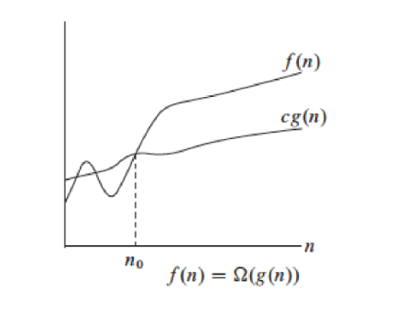
Big-Omega (Ω)

Slide 21
Asymptotic Analysis
Big-Theta (θ):
Tight bound of f(n)
Definition:
f(n) = θ(g(n)) if there exist positive constants c₁,c₂ and n₀ such that
0 ≤ c₁ g(n) ≤ f(n) ≤ c₂ g(n) for all n ≥ n₀

Slide 22
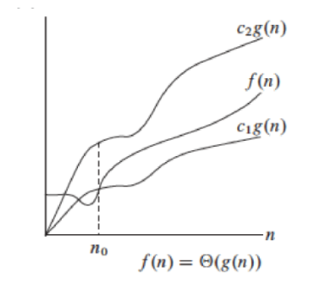
Big-Theta (θ)

Slide 23
Thanks

